Slide 1
Introductory General Chemistry
Chemistry 3A
S. M. Halloran

Slide 2
Scientific Method
Atomic Theory
Subatomic Structure: protons, electrons, neutrons
Atomic Properties
Patterns of matter: Periodic Table
Electric properties of atoms: ions
Neutrons and isotopes
Atomic mass: weight average of atoms
Review

Slide 3
Recommendations for Successful Performance in Chem 3A
Syllabus
The syllabus is your friend, your map to how the course is supposed to go
Understand it well: generally, answers questions of highest importance to students
Broad overview or outline of course content
Materials for course: freely accessible online “book”, lab gear (coat + goggles), scientific-grade calculator
Grading: components of performance in course
Examinations: midterms and final, quizzes
“Homework”:
Laboratory part of course: reports of experiments

Slide 4
Recommendations for Successful Performance in Chem 3A
Online Systems/Tools
Canvas
Email:

Slide 5
Recommendations for Successful Performance in Chem 3A
Interaction between instructor & student(s)
Part-time instructors interact through Canvas and email

Slide 6
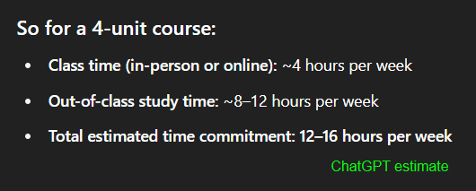
Recommendations for Successful Performance in Chem 3A
Attendance
Being at lecture & certainly being in the lab is not optional: attendance is recorded
Time Commitment
Reading, homework, study for exams/quizzes
Generally thought to be at least twice time/effort commitment of the hours (units) of lecture+lab: 4 units → 8-12 hours additional per week

Slide 7
Teamwork
Throughout your career, you will learn that projects and programs have teams of people in order to get work done successfully.
While tasks in projects are done by individuals performing roles as part of the team, the overall work is a product of the team
The “project” here at FCC in this course is learning chemistry, so everyone will be part of a team
This team is your study group

Slide 8
The Study Group
The Canvas LMS app was used to randomly group students into study groups in this course
The study group is only one facet of your learning process, intended to initiate you into being part of a team in your learning goal
Your instructor (me), your peers, resources of the College (tutors, tutoring services, counselors, other support staff) are always ready & present too

Slide 9
Communication Plan
All projects—like your success in this course—write out a communication plan
This is about what and how to communicate to move the project along
What to communicate
Asking about how to solve a problem, understanding details of an assignment, when is a deadline
Helping each other with reminders, setting up an interactive meeting online or in person
How to communicate
Email, phone text or a call
Canvas online system

Slide 10
Artificial Intelligence in Learning & Academics
The elephant in the room? Have you been talking about it in your course of learning?
Will be transformative, but…
useful to you IF you use it properly
ChatGPT/Bing CoPilot/Gemini don’t initiate the “what if” and “why” that drives discovery and exploration
A.I. does not and will not replace humans in asking questions that push discovery
Learning the foundations of a discipline—that is, getting that Associates or Bachelors or Doctoral degree—makes you that better thinker who is asking “what if” and “why”
Doing that “homework”…
Helps you pass the test, yes
But also builds you as a discoverer, explorer, researcher, thinker

Slide 11
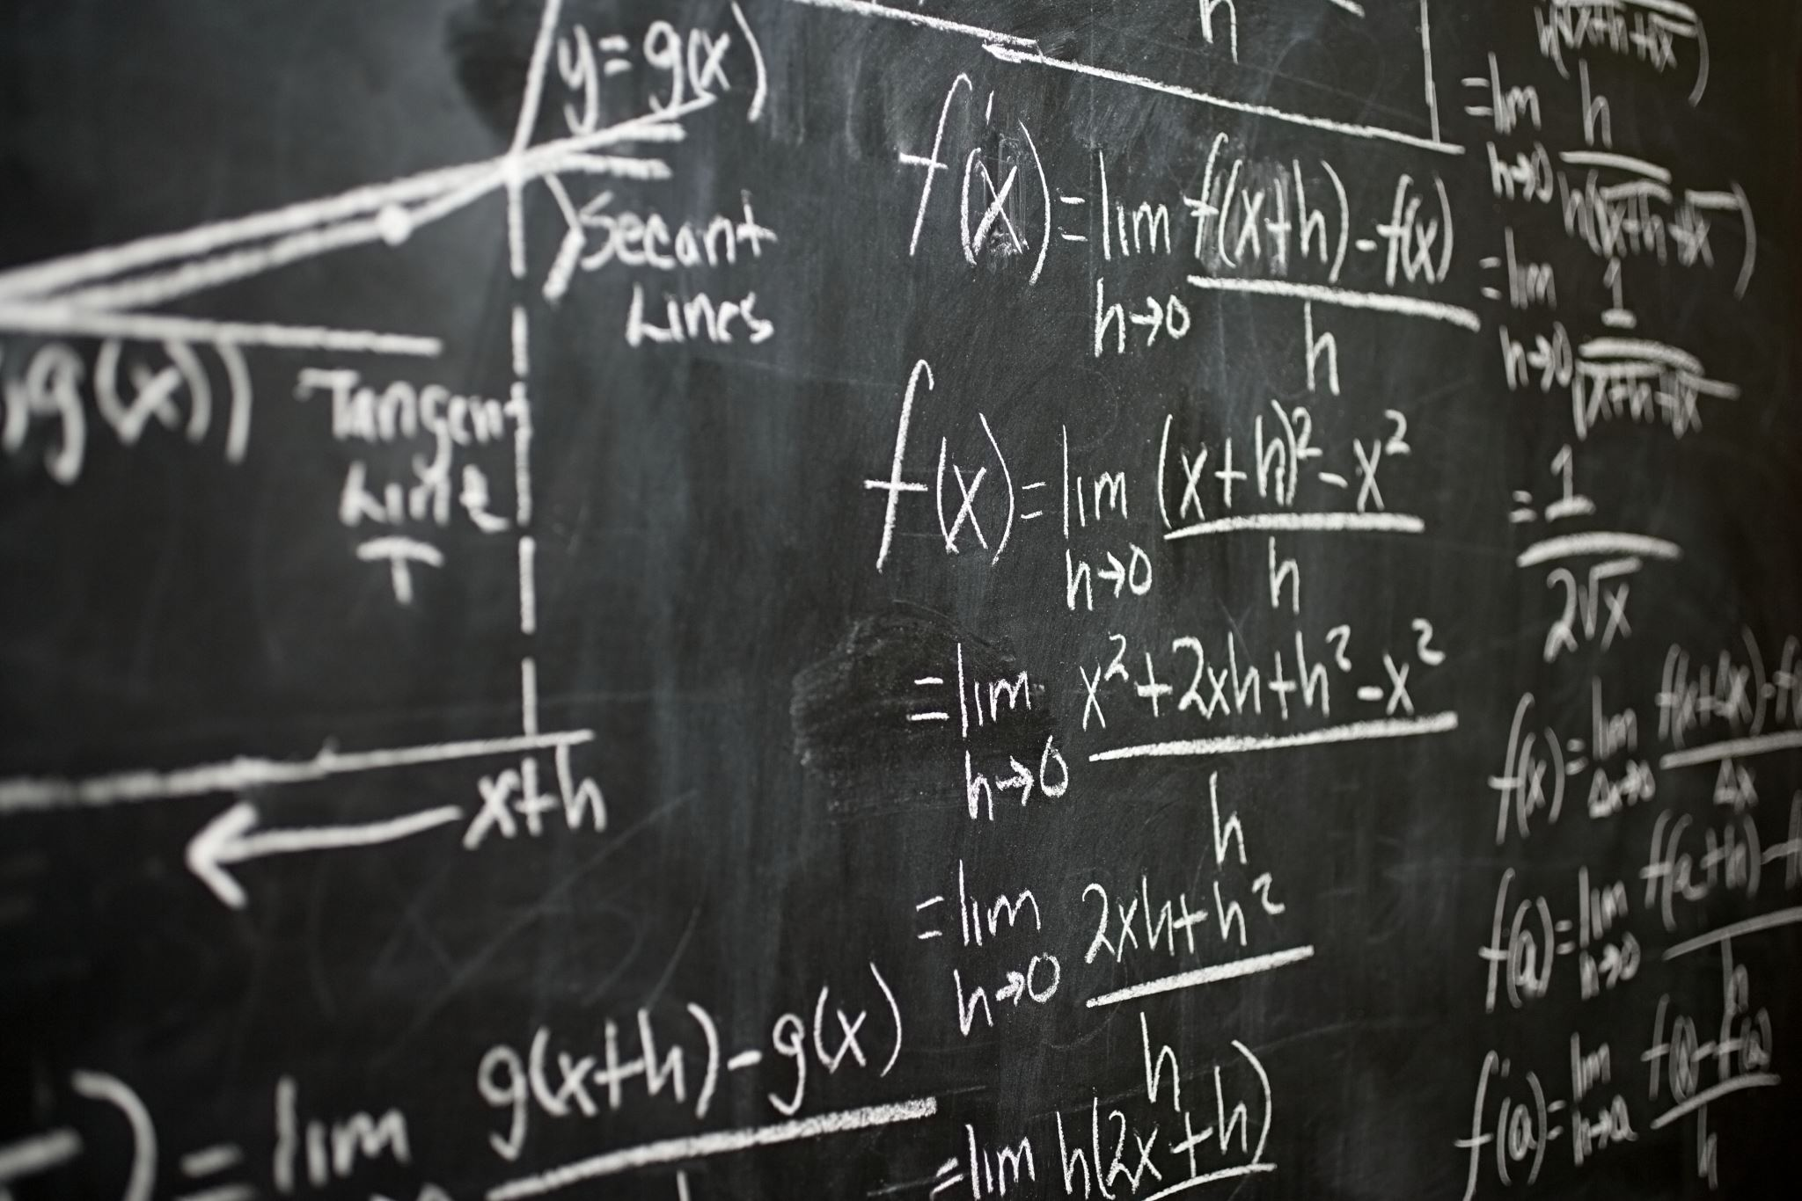
Numbers, Calculations, Measurements in Chemistry

Slide 12
Quantities
Number | Dimension
1 | mile
3 | teaspoons

Slide 13
Scientific Notation
A way of expressing numerical values
Format: d.mmm × 10^{n}
Part | n.mmm
Part Name | Significand (preferred), Coefficient, (Mantissa is obsolete term)
Part Property | Number greater than or equal to 1.0 and less than 10. This number properly express significant digits
Part | 10^{n}
Part Name | Exponent
Part Property | Exponent of 10 where n is integer, negative, positive (note 10⁰ = 1)

Slide 14
Scientific Notation
decimal point moves to right
1. = 10⁰
10. = 10¹
100. = 10²
decimal point moves to left
0.1 = 10⁻¹
0.01 = 10⁻²
0.001 = 10⁻³
1 atmosphere (atm) = 101,325 Pascals (Pa)

Slide 15
Scientific Notation
Is the number less than 10 and greater than 1?
You don’t really need scientific notation, because it will be [ d.mmm × 10⁰ ] and 10⁰ = 1, so → d.mmm
Otherwise take the number and express as d.mmm
If original number is greater than d.mmm you have to multiply by 10¹ n times to get to original number, so n will be positive (greater than zero): n × 1 = n (greater than zero)
If original number less than d.mmm you have to multiply by 10⁻¹ n times to get to original number, so n will be positive (greater than zero): n × -1 = -n (less than zero)

Slide 16
Scientific Notation
If original number is greater than d.mmm you have to multiply by 10¹ n times to get to original number, so n will be positive (greater than zero): n × 1 = +n
Your book: “if you moved decimal point to the left n places, then n is positive”
35 → 35. → 3.5 moved to left 1 place
3.5 × 10¹
23849 → 23849. → 2.3849 moved to left 4 places
2.3849 × 10⁴

Slide 17
Scientific Notation
If original number less than d.mmm you have to multiply by 10⁻¹ (or divide by 10) n times to get to original number, so n will be negative (less than zero): n × -1 = -n
Your book: “if you moved decimal point to the right n places, then n is negative”
0.0000035 → 3.5 moved to right 6 places
3.5 × 10⁻⁶
0.023849 → 2.3849 moved to right 2 places
2.3849 × 10⁻²

Slide 18
Scientific Notation
Patterns for memorizing
decimal point movement – number being changed – final exponent value
Left – Large – Positive
Right – Small – Negative
Positive and negative for exponent, not significand!
34249 → 3.4249 × 10⁴
-34249 → -3.4249 × 10⁴
0.0034249 → 3.4249 × 10⁻³
-0.0034249 → -3.4249 × 10⁻³

Slide 19
Scientific Notation
Scientific notation is actually a product of two numbers: the significand and a power of 10!
34249 = 3.4249 × 10⁴ = 3.4249 × 10,000 = 34249
-34249 = -3.4249 × 10⁴ = -3.4249 × 10,000 = -34249
0.0034249 = 3.4249 × 10⁻³ = 3.4249 × 0.001 = 0.0034249
-0.0034249 = -3.4249 × 10⁻³ = -3.4249 × 0.001 = -0.0034249
Use this feature to confirm whether you converted a number to scientific notation properly!

Slide 20
Significant Digits
Significant digits indicate the precision, the confidence of a single measurement
Also called significant figures
Measurement/Value | Significant Digits | Explanation
1.7 | 2 | All non-zero digits significant
1.732 | 4
17.32704 | 7 | Zeroes between non-zero digits are significant

Slide 21
Significant Digits
Measurement/Value | Significant Digits | Explanation
0.0045 | 2 | leading zeroes after decimal point not significant
0.00450 | 3 | trailing zeroes after decimal are significant
1200 | 2
1200. | 4 | assertion of decimal point makes significant
0.000 | 0 | no non-zero digits at all
1000.0 | 5 | adding decimal point and any zeroes after it makes all digits significant
100 | 1 | evaluated like the “1200” example above
1.200 × 10⁻³ | 4 | all digits in scientific notation should be significant

Slide 22
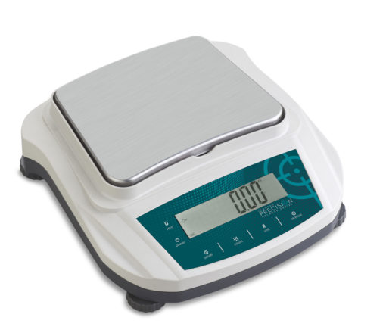
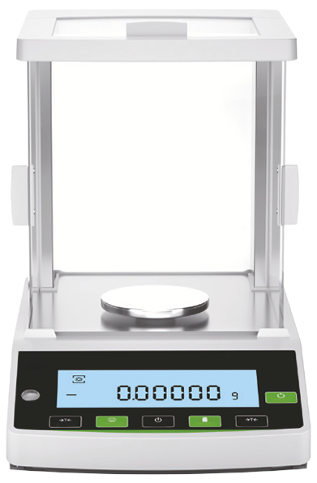
Significant Digits
Significant digits indicate the precision, the confidence of a single measurement
Preparative balance
Measuring quantities usually 0.1 g (100 mg) or greater
used to weigh masses for starting a chemistry experiment
Precision example: 3.4 g sodium chloride (NaCl)
Analytical balance
Measuring quantities usually down to 0.0001 g (0.1 mg or 100 µg) or greater
used to weigh masses for determining yield of product at end of a chemistry experiment
Precision example: 0.0241 g copper(II) sulfate pentahydrate

Slide 23
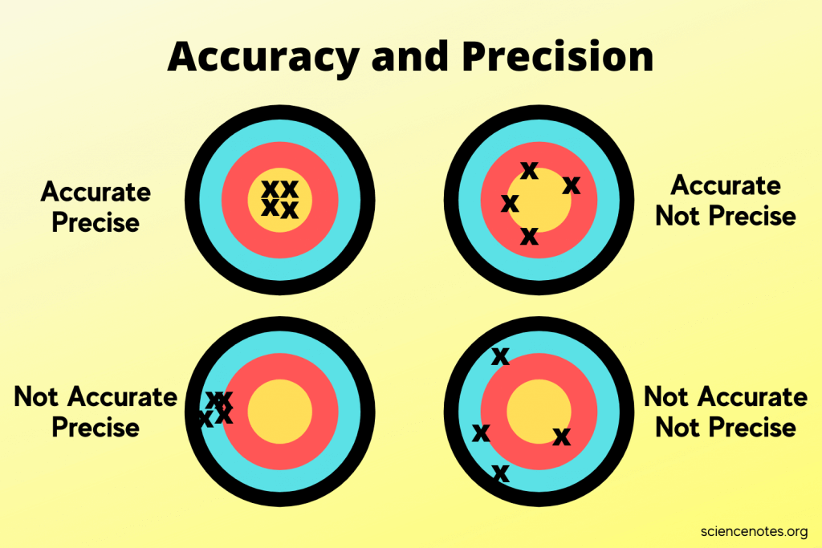
Significant Digits
Multiple Measurements
Precision – an indicator of how measurements repeat the value being measured
Accuracy – an indicator of how measurements get to the true value

Slide 24
Significant Digits in Scientific Notation
The rules on significant digits in numerical values always apply in scientific notation
2.69 × 10⁻⁵ = 0.0000269 (3 significant digits)
2.69000 × 10⁻⁵ = 0.0000269000 (6 significant digits)
2.69 × 10³ = 2690 (3 significant digits)
You still have add the zero to get standard form of number as integer
2.69000 × 10³ = 2690.00 (6 significant digits)

Slide 25
Significant Digits in Scientific Notation
The rules on significant digits in numerical values always apply in scientific notation
2.69 × 10⁻⁵ = 0.0000269 (3 significant digits)
2.69000 × 10⁻⁵ = 0.0000269000 (6 significant digits)
2.69 × 10³ = 2690 (3 significant digits)
You still have add the zero to get standard form of number as integer
2.69000 × 10³ = 2690.00 (6 significant digits)

Slide 26
“Conversion Factors”
Calculations in chemistry frequently require converting between the dimensions of a quantity
Volume: fluid ounces to milliliter (“fl oz” to “ml”)
Temperature: Celsius to Kelvin (“°C” to “K”)
Pressure: torr to atmosphere (“torr” to “atm”
Conversions not just about measurement systems but also include scales which are powers of 10
1 liter (L) = 1000 milliliters (ml, sometimes mL)
1 kilogram (kg) = 1000 grams (g)

Slide 27
Conversion Nomenclature
Prefix | Meaning | Example
Multiple of 10 (greater than 1)
kilo- (k) | 10³ = 1000 | 2 kilograms (kg) = 2000 grams
mega- (M) | 10⁶ = 1,000,000 | 3.7 megajoules (MJ) = 3,700,000 J
giga- (G) | 10⁹ = 1,000,000,000 | 10 gigahertz (GHz) = 10,000,000,000 Hz
Submultiples of 10 (fractions of 1)
deci- (d) | 10⁻¹ = 1/10 | 1 deciliter (dL, dl) = 0.1 L
centi- (c) | 10⁻² = 1/100 | 2.54 centimeter (cm) = 0.0254 m
milli- (m) | 10⁻³ = 1/1000 | 14 millibar (mbar) = 0.014 bar
micro- (u/µ) | 10⁻⁶ = 1/1000000 | 259 microliters (µl, ul, µL, uL) = 0.000259 L
nano- (n) | 10⁻⁹ = 1/1000000000 | 34 nanograms (ng) = 0.000000034 g
pico- (p) | 10⁻¹² = 1/100000000000 | 250 picoliters (pL) = 0.00000000025 L
femto- (f) | 10⁻¹⁵ =1/ 1000000000000000 | 4.3 femtomoles (fmol) = 0.0000000000000043 mol
Dimensions in green are often used in chemistry

Slide 28

Density
How much mass is in a given volume
The math definition:
Greek letter rho (ρ) is symbol for density
$$density= \frac{mass}{volume}$$
$$ρ=\frac{m}{V}$$

Slide 29
Temperature
A measure of the average kinetic energy of particles in a substance
Not energy itself, but an indicator or measure of energy

Slide 30
Measuring Temperature

Slide 31
Temperature Scales
Three scales (measurement types) are used to get a value of temperature
Thermometers usually involve expansion or contraction of calibrated sealed tube of mercury (Hg) or dyed-alcohol
Scale | Water Property
 | freezing point | boiling point
Fahrenheit | 32° F | 212° F
Celsius (centigrade) | 0° C | 100° C
Kelvin | 273 K | 373 K

Slide 32




Converting Temperature
Conversions apply basic algebraic principles of sloped lines
s$\text{lope} =\frac{373 −273}{100 − 0}$ = 1
$$°C =K −273$$
2$73 =1 ×0+\text{intercept}$
Intercept = 273
K$=°C+273$

Slide 33


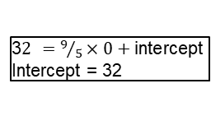

Converting Temperature
Fahrenheit not used in chemistry, but be prepared to convert.
s$\text{lope} =\frac{212 −32}{100 − 0}=\frac{180}{100}=\frac{9}{5}$
$$°C =\frac{5}{9}\left(°F −32\right)$$
3$2 =9/5×0+\text{intercept}$
Intercept = 32
°$F =\frac{9}{5}°C+32$

Slide 34
Introduction to Matter

Slide 35
The Atom
Structure, Components, Properties

Slide 36
The Atom
Atoms are made of three subatomic particles
Protons
which actually give the element its identity
Electrons
chemistry is really about electrons, because it is electrons that allow atoms to bond to each other
Neutrons
it takes about 1800 electrons to equal mass of a proton, and the neutron is slightly bigger than the proton by 0.15%.
Because neutrons have a mass that is slightly higher than sum of a proton & electron, and because neutrons have been shown to decay to a proton, electron, and some other particles in physics, speculation is that a neutron is special gluing of a proton and electron.

Slide 37
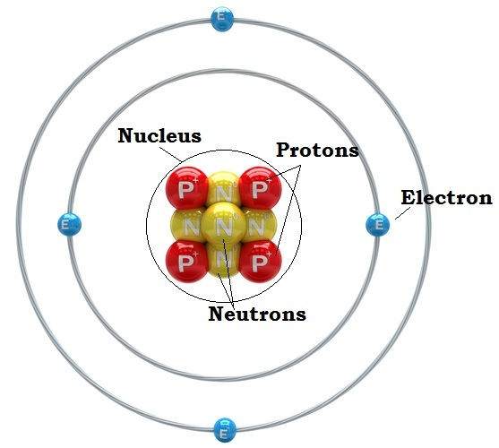
Nucleus & Orbitals
Protons and neutrons organized in the nucleus
Electrons spatially located outside of the nucleus
Electrons "orbit" the nucleus in orbitals but not like planets revolving around the sun
Their position/location is determined by probabilities calculated by complex mathematical expressions
Each orbital pairs two electrons of opposite spin
Yes, electrons have a spin just as the Earth rotates on an axis, and this spin generates a magnetic field

Slide 38

Atomic Weight
Why does hydrogen (H) have an atomic weight of 1.0079?
How is it calculated?

Slide 39
Atomic Weight Explained
Atoms are made of three subatomic particles
Protons
which actually give the element its identity
Electrons
chemistry is really about electrons, because it is electrons that allow atoms to bond to each other
Neutrons
it takes about 1800 electrons to equal mass of a proton, and the neutron is slightly bigger than the proton by 0.15%.
In fact, a neutron may be the combination of the mass of both 1 proton and 1 electron plus the Einstein energy (E = mc²) necessary to slam them together.
Neutrons can undergo radioactive decay into a particle that is +1 (proton or anti-proton) and –1 (electron) particles

Slide 40
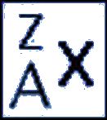
Atomic Weight Explained
Elements all have the same number of protons
But elements can have different number of neutrons
An element with different numbers of neutrons is an isotope of the element
When referring to an isotope of an element, use this
Where
× is element symbol (e.g, hydrogen = H)
A is atomic number, = # protons (A = 1 for H)
Z is mass number, = #protons + #neutrons

Slide 41
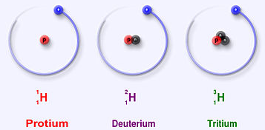
Atomic Weight Explained
Hydrogen has three isotopes:
Protium (¹₁H)
1 proton, 0 neutrons
usually just called "hydrogen"
99.9885% of all hydrogen isotopes in nature is this isotope
Deuterium (²₁H)
1 proton, 1 neutron
It is a stable isotope
0.0115% of hydrogen isotopes is deuterium in nature
Tritium (³₁H)
1 proton, 2 neutrons
It is an unstable isotope, meaning it is radioactive
Probably less than 0.00000001% in nature

Slide 42
Atomic Weight Explained
Atomic weight is calculated by taking the mass of each isotope in atomic mass units and multiplying it by the abundance of each, then summing it all up
Thus
1.007825032 × 0.999885 + 2.0141017778 × 0.000115
= about 1.0079!
Isotope | Mass (amu) | Abundance
¹₁H | 1.007825032 | 0.999885
²₁H | 2.0141017778 | 0.000115

Slide 43
The Periodic Table

Slide 44
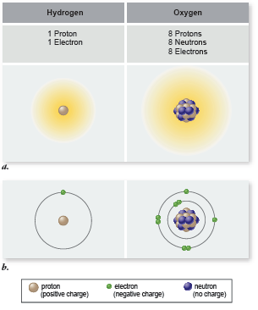
Elements
Elements all have the same number of protons
But elements can have different number of neutrons
An element with different numbers of neutrons is an isotope of the element
When referring to an isotope of an element, use this
Where
× is element symbol (e.g, hydrogen = H)
A is atomic number, = # protons (A = 1 for H)
Z is mass number, = #protons + #neutrons

Slide 45
Hydrogen
Hydrogen has three isotopes:
Protium (¹₁H)
1 proton, 0 neutrons
usually just called "hydrogen"
99.9885% of all hydrogen isotopes in nature is this isotope
Deuterium (²₁H)
1 proton, 1 neutron
It is a stable isotope
0.0115% of hydrogen isotopes is deuterium in nature
Tritium (³₁H)
1 proton, 2 neutrons
It is an unstable isotope, meaning it is radioactive
Probably less than 0.00000001% in natural abundance

Slide 46
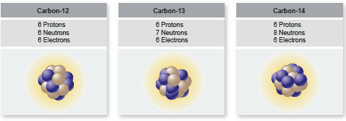
Carbon
Organic chemistry is the chemistry of carbon
Total of 6 electrons in two shells (n =1 and n = 2)
Will use 4 electrons in its valence shell to bond with other atoms
Other atoms it bonds with in biological organisms:
H, N, O, and other C atoms mostly
S, P atoms also

Slide 47
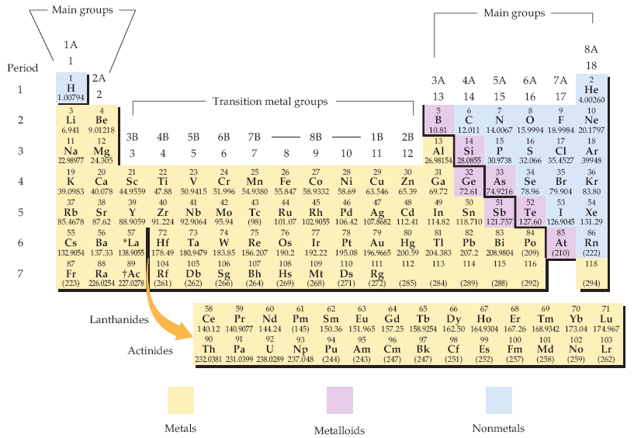
Periodic Table of Elements
Biologists should know what elements are (1) metals and (2) nonmetals generally
The periodic table of the elements. Each element is identified by a one- or two-letter symbol and is characterized by an atomic number. The table begins with hydrogen (H, atomic number 1) in the upper left-hand corner and continues to the yet unnamed element with atomic number 118. The 14 elements following lanthanum (La, atomic number 57) and the 14 elements following actinium (Ac, atomic number 89) are pulled out and shown below the others.
Elements are organized into 18 vertical columns, or groups, and 7 horizontal rows, or periods. The two groups on the left and the six on the right are the main groups; the ten in the middle are the transition metal groups. The 14 elements following lanthanum are the lanthanides, and the 14 elements following actinium are the actinides; together these are known as the inner transition metals. Two systems for numbering the groups are explained in the text. Those elements (except hydrogen) on the left-hand side of the zigzag line running from boron (B) to astatine (At) are metals, those elements to the right of the line are nonmetals, and most elements abutting the line are metalloids.
McMurry et al, Fundamentals of General, Organic and Biological Chemistry, 6 Ed, p 58

Slide 48
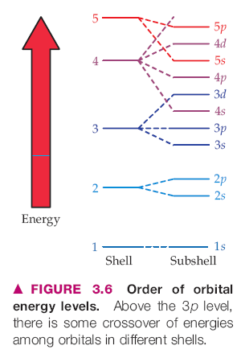
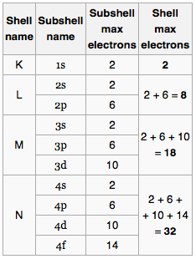
Shells of Electrons & Periodic Table
Each period (row) of the Periodic Table corresponds to a "shell" of electrons
Shells are designated by the principal quantum number n by chemists: n = 1, 2, 3, …
letters K, L, M, N, O, … by physicists
Within the shells are subshells: s, p, d, f
In quantum chemistry/physics, each electron is described by a set of four quantum numbers: {n, l, m_{l}, m_{s}}
There is a correspondence between a shell's energy and its shell number/letter (distance from nucleus): higher shell number relates to higher energy of the electron
The maximum number of electrons in each shell (period) is 2, 8, 8, 18, 18, 32, 32, ..

Slide 49
The Valence Shell
The outermost shell of electrons is where all the chemistry happens
Atoms want to have "complete" shells
This means shedding or giving up electrons if there are too few
Grabbing electrons from other atoms if they need only a few
Giving up electrons means acquiring a positive + charge
Grabbing electrons means acquiring a negative – charge
In forming molecules or crystals, atoms form complete stable shells by having the complete set of electrons in their valence shell, whether or not they share them with other atoms

Slide 50
Electronegativity
The affinity of an atom for one or more electrons
The factors affecting electronegativity are
atom's need to acquire electrons to complete shell
size of atom: smaller atoms more electronegative
atoms are given a value that indicates their electronegativity: the higher the value, the higher the affinity (the more the atom wants electrons)
decreasing order of electronegativity: F, O, Cl, N, Br, I, C, S, Se, H, P
that is, F wants it most, P wants it least in that list
Differences in electronegativity account for type/character of bonding (shown in later slide)

Slide 51
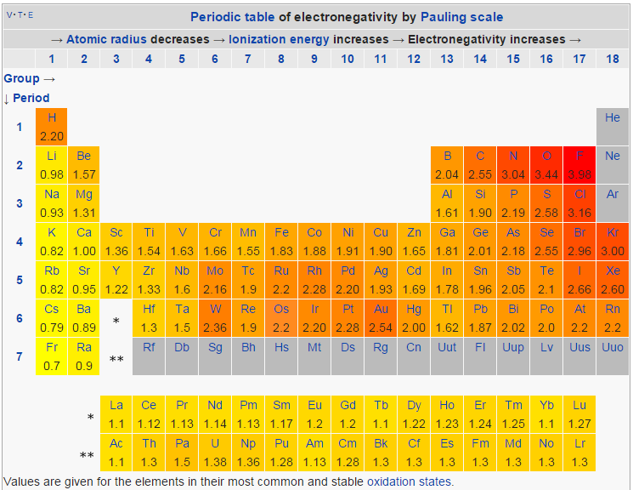
Electronegativity Quantitated
http://en.wikipedia.org/wiki/Electronegativity

Slide 52
Nuclear Chemistry

Slide 53
Chemical Bonding

Slide 54
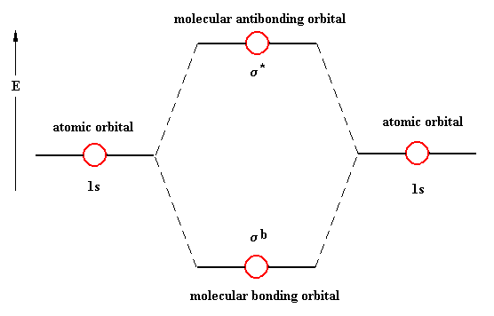
Bonding
Atoms bond using electrons
remember: chemistry is really about the electrons
Electrons in atomic orbitals (AOs) come together between atoms in molecular orbitals (MOs), forming a bonding MO
MOs have two paired (opposite spin) electrons just like AOs
s subshell AOs form σ (sigma)-type MOs (bonds)
p subshell AOs form π (pi)-type MOs (bonds)
there are anti-bonding MOs: they are an excited state type of orbital which, when filled with electrons, actually result in bond-breaking between atoms, not bond-making

Slide 55
Bonding Types & Strength
Type | Description | Strength (kcal/mol)
Ionic / Electrostatic | One atom gives up its electron(s) to another which really wants them: the result is ionized atoms bonding because of electrical attraction (unlike charges) | 50-150
Covalent | Two atoms share the electrons in the bond, neither having a strongly competitive affinity for the electrons (small difference in electronegativity) | 50-100 (single) 100-200 (double) 200-250 (triple)
Hydrogen Bonding | The hydrogen (H) atom is "shared" between two more electronegative atoms | 2-10
Hydrophobic | A "bonding" driven by solvent with polar molecule (H₂O) that prefers to bond to itself (oil & water don't mix) | ND
van der Waals | bonding caused by "induced polarity" from one molecule to another causing a temporary weak electrical attraction | 0.5-1.0

Slide 56
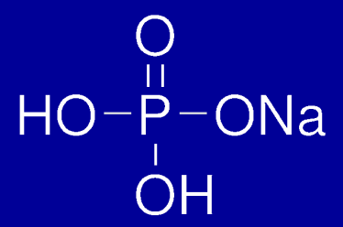
The Covalent Bond
Two atoms that share equally the pair(s) of electrons
Atoms bonding with selves (diatomic molecules) should always be covalent H₂, O₂, N₂, F₂, Cl₂, Br₂, I₂
Can be single, double, and triple bonds between atoms
H₃C—CH₃ (ethane) sigma bond
H₂C=CH₂ (ethene) sigma + pi bond
HC≡CH (ethyne/acetylene) sigma + 2 pi bonds
H—H, O=O, N≡N, F—F, Cl—Cl, Br—Br

Slide 57
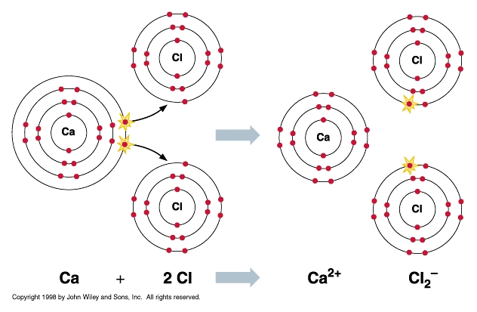
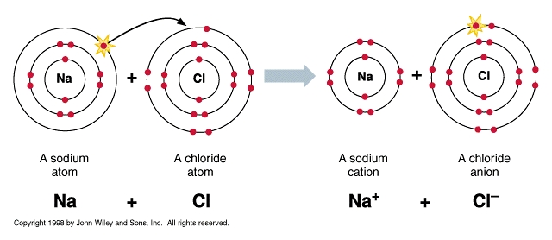
The Ionic / Electrostatic Bond
The bond created by an electrostatic attraction between positive and negative charges resulting from the complete transfer of electrons from one atom to another Na → Na⁺ + e– Cl + e– → Cl– --------------------------------- Na + Cl → Na⁺ + Cl–

Slide 58
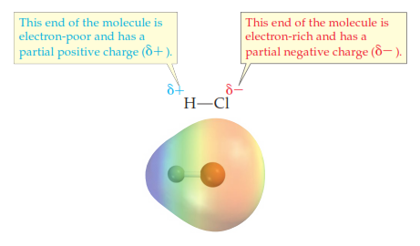
A Polar Covalent Bond
A type of bond that has a mix of covalent and ionic character
The difference in electronegativity of atoms is not such that one atom fully grabs another
Bonds that are polar covalent: O–H, N–H, H–Cl/F (list shown later)
The polar covalent bond accounts for the hydrogen bond

Slide 59
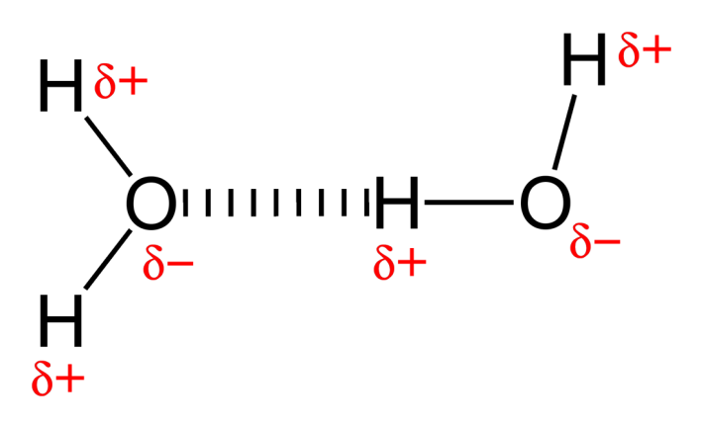
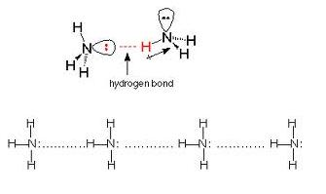
The Hydrogen Bond
The bonding of an H atom already covalently bonded to a more electronegative atom to another more electronegative atom on different molecule
The presence of (a) nonbonding electron pairs in the more electronegative atom is a factor
The presence of N–H and O–H groups in countless biomolecules makes the hydrogen bond significant in all aspects of biochemistry
The double-strandedness of DNA and RNA is because of H-bonding. Polypeptide folding in proteins makes use of H-bonding

Slide 60
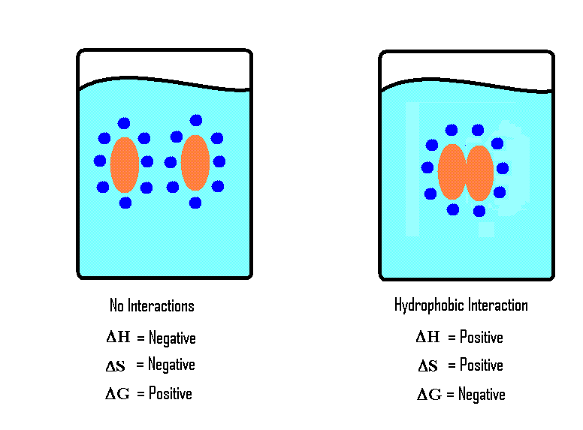
Hydrophobic Interactions
There are no real forces between molecules in hydrophobic molecules associating or clustering together
Instead, the free energy (G) of the solution favors water bonding with itself (by H-bonding) rather than interacting with molecules with which it has no affinity
http://chemwiki.ucdavis.edu/@api/deki/files/8648/image9.GIF

Slide 61
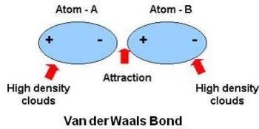
van der Waals Forces
The spatial location of negative charge ("electron cloud") is not perfectly radially distributed about the spherical atom at each moment in time
This transient change in charge symmetry in one atom affects neighboring atoms

Slide 62
Liquids & Solids

Slide 63
Atomic Weight Explained
Atomic weight is calculated by taking the mass of each isotope in atomic mass units and multiplying it by the abundance of each, then summing it all up
Thus
1.007825032 × 0.999885 + 2.0141017778 × 0.000115
= about 1.0079!
Isotope | Mass (amu) | Abundance
¹₁H | 1.007825032 | 0.999885
²₁H | 2.0141017778 | 0.000115

Slide 64
Gases

Slide 65
Atomic Weight Explained
Atomic weight is calculated by taking the mass of each isotope in atomic mass units and multiplying it by the abundance of each, then summing it all up
Thus
1.007825032 × 0.999885 + 2.0141017778 × 0.000115
= about 1.0079!
Isotope | Mass (amu) | Abundance
¹₁H | 1.007825032 | 0.999885
²₁H | 2.0141017778 | 0.000115

Slide 66
Solutions

Slide 67
Atomic Weight Explained
Atomic weight is calculated by taking the mass of each isotope in atomic mass units and multiplying it by the abundance of each, then summing it all up
Thus
1.007825032 × 0.999885 + 2.0141017778 × 0.000115
= about 1.0079!
Isotope | Mass (amu) | Abundance
¹₁H | 1.007825032 | 0.999885
²₁H | 2.0141017778 | 0.000115

Slide 68
Stoichiometry

Slide 69
Substance Quantitation
prefixes: giga 10⁹, mega 10⁶, kilo 10³, deca 10¹, deci 10^{–1}, centi 10^{–2}, milli 10^{–3}, micro 10^{–6}, nano 10^{–9}, pico 10^{–12}, femto 10^{–15}, atto 10^{–18}
Mass
units: grams, kilograms, moles, # molecules
not weight!
Conversions:
When balancing or determining yields from chemical equations, always convert to moles first
Volume
units: cubic ___meters: cm³, mm³, L(iters)
Conversions: 1 mL = 1 cm³, 1 L = 1000 ml

Slide 70
Substance Quantitation
Concentration
units: G/L, mol/L, M, %(w/v), %(v/v), ppm, etc, etc
mass of a solute in the volume of a solution
solution = solute + solvent
note density = mass/volume, but of a pure substance!
mass of solute = concentration × volume
stock solutions / reagents
[ g ←AW/MW→ mole ] weighed out: add solvent to final volume
dilutions: C_{concentrated} ×V_{concentrated} = C_{dilution} × V_{dilution}

Slide 71
Empirical Formula
The empirical formula of any compound / molecule will be
A_{x}B_{y}C_{z}
where A, B, and C are the component atoms of the compound and the ×, y, and z subscripts represent the relative molar content of each of the component atoms
The ×, y, z subscript values do not necessarily the actual atom numbers in a compound. The empirical formula for the carbohydrate glucose is:
CH₂O
But the actual molecular formula—which is NOT the same as the empirical formula—is
C₆H₁₂O₆
The molecular formula is thus a multiple of the empirical formula
Note if a subscript value = 1, it is omitted

Slide 72
Empirical Formula from Percent Composition
You will need the atomic weights (from the periodic table) of all component atoms
Assume you have 100 grams of the compound/molecule: calculate the number of grams of each component atom from the percent of the component atom
From each component atom mass in grams, compute the number of moles of each component atom
Compute the relative mole ratios of all component atoms to the one component atom with the lowest mole value
That is, divide the mole values of all component atoms by the atom with the lowest mole value

Slide 73
Empirical Formula from Percent Composition
Worked Example #1
Percent composition of copper chloride is 64.1% Cu and 35.9% Cl. What is empirical formula?
That is we want to know × and y of Cu_{x}Cl_{y}
atomic weights: Cu = 63.546 g/mol, Cl = 35.453 g/mol
Component atom masses in grams of 100 grams of copper chloride:
(0.641)(100 g) = 64.1 g Cu (0.359)(100 g) = 35.9 g Cl
iii) # moles of each component atom: (64.1 g Cu)(1 mole/63.546 g Cu) = 1.01 ~ 1
(35.9 g Cl)(1 mole/35.453 g Cl) = 1.01 ~ 1
iv) dividing by lowest mole value since both are equal to 1, they are both equal in mole content. So empirical formula is CuCl

Slide 74
Empirical Formula from Percent Composition
Worked Example #2
Trichloroethylene (TCE) is 18.25% carbon, 0.77% hydrogen, and 80.99% chlorine by weight. What is empirical formula?
That is we want to know TCE with C_{x}H_{y}Cl_{z}
atomic weights: C = 12.011 g/mol, H = 1.008 g/mol, Cl = 35.453 g/mol
Component atom masses in grams of 100 grams of TCE:
C: (0.1825)(100 g) = 18.25 g C H: (0.0077)(100 g) = 0.77 g H
Cl: (0.8099)(100 g) = 80.99 g Cl
iii) # moles of each component atom: C: (18.25 g C)(1 mole C/12.011 g C) = 1.52
H: (0.77 g H)(1 mole H/1.008 g H) = 0.764
Cl: (80.99 g Cl)(1 mole Cl/35.453 g Cl) = 2.28
iv) dividing by lowest mole value C: 1.52 / 0.764 = 1.99 ~ 2, H: 0.764 / 0.764 = 1,
Cl: 2.28 / 0.764 = 2.98 ~ 3
Empirical formula: C₂HCl₃

Slide 75
Balancing Reactions
These rules come first in the balancing of all chemical reactions ("equations")
Mass is always conserved
Charge is always conserved
Additional rule
Compounds / molecules must actually exist

Slide 76
Balancing Reactions: Mass Conservation
If there are N atoms of element × on the left side of the arrow (reactants), there must be N atoms of element × on the right side of the arrow (products)
Pay attention to coefficients and subscripts!!
2 H₂O → 2 H₂ + O₂
There are 4 atoms of H & 2 atoms of O on both sides of the arrow
2 Na + 2 H₂O → 2 NaOH + H₂
There are 2 atoms of Na, 4 atoms of H, and 2 atoms of O on both sides of the arrow
2 + 2 H₂O → 2 NaOH + H₂

Slide 77
Balancing Reactions: Charge Conservation
These rules come first in the balancing of all chemical reactions ("equations")
Mass is always conserved
If there are N atoms of element × on the left side of the arrow (reactants), there must be N atoms of element × on the right side of the arrow (products)
Pay attention to coefficients and subscripts!!
2 H₂O → 2 H₂ + O₂
There are 4 atoms of H & 2 atoms of O on both sides of the arrow
Charge is always conserved

Slide 78
Balancing Reactions: Half Reactions
These rules come first in the balancing of all chemical reactions ("equations")
Mass is always conserved
If there are N atoms of element × on the left side of the arrow (reactants), there must be N atoms of element × on the right side of the arrow (products)
Pay attention to coefficients and subscripts!!
2 H₂O → 2 H₂ + O₂
There are 4 atoms of H & 2 atoms of O on both sides of the arrow
Charge is always conserved

Slide 79
Chemical Reactions

Slide 80
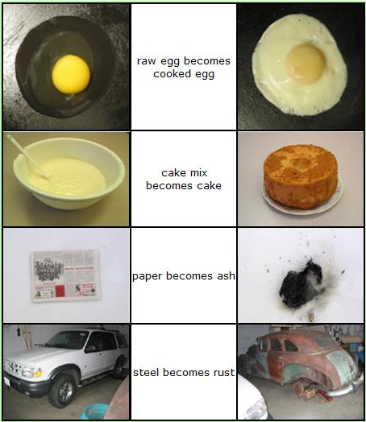
Chemical Reactions
Bond breaking and formation
Movements of electron (singly or as pairs) from one atom or molecule to another
Atoms or molecules acquiring electrical charges positive or negative (or losing them: uncharged)
Common, daily chemical reactions
https://wikis.engrade.com/science1012011/chemicalreactions

Slide 81
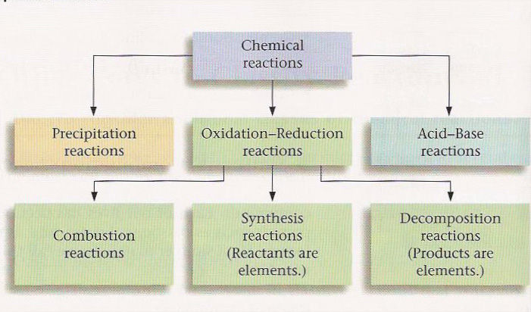
Types of Chemical Reactions
6 Types of Reactions
Combustion C₁₀H₈ + 12 O₂ → 10 CO₂ + 4 H₂O
Synthesis 8 Fe + S₈ → 8 FeS
Decomposition 2 H₂O → 2 H₂ + O₂
Single Displacement Mg + 2 H₂O → Mg(OH)₂ + H₂
Double Displacement Pb(NO₃)₂ + 2 KI → PbI₂ + 2 KNO₃
Acid-Base HBr + NaOH → NaBr + H₂O
http://quinton.pbwiki.com/f/textbookfig712edit.jpg

Slide 82
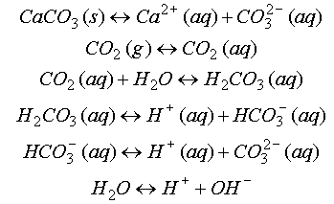
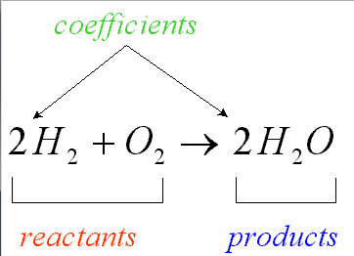
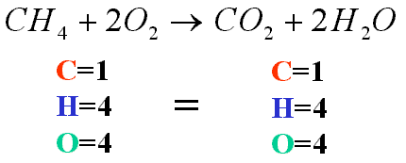
Balancing Mass & Charge
Laws of conservation of mass and electrical charge require that chemical (reaction) equations be balanced for mass and charge
http://ion.chem.usu.edu/~sbialkow/Classes/3600/Overheads/Carbonate/image020.gif
http://www.mikeblaber.org/oldwine/chm1045/notes/Stoich/Equation/balance4.gif

Slide 83
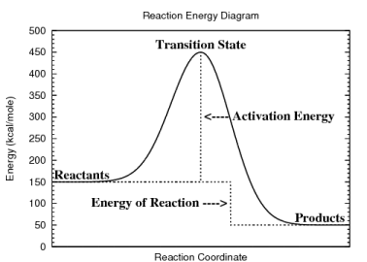
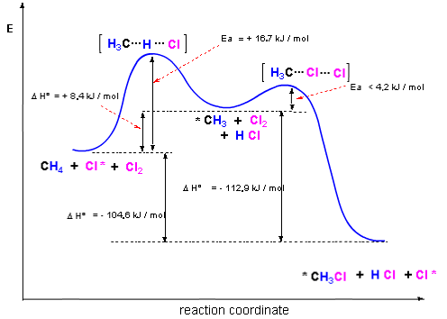
Reaction Energy Diagrams
Diagrams show changes in the (potential) energy along a "reaction coordinate"
A reaction coordinate is basically a state of the reaction: reactants, activated complexes or transition states, products
Often show detail of energy values
http://www.personal.kent.edu/~cearley/gen50/review/rxnEnergy.png

Slide 84
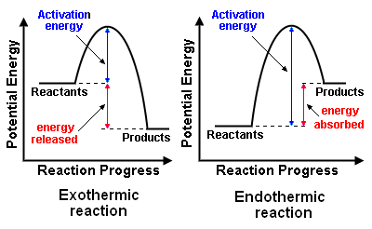
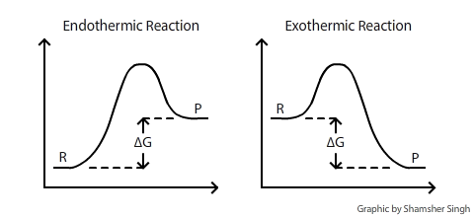
Endothermic & Exothermic
Exothermic Reactions reactions releasing energy: work done, heat released
gasoline combustion
Endothermic Reactions reactions requiring energy: put them on the hot plate
dissolving urea in water
http://chemwiki.ucdavis.edu/@api/deki/files/120/delta_g_diagram.png
http://en.citizendium.org/images/f/fb/ExoEndo_Reax.png

Slide 85
Equilibrium
A lot of math problems can be more easily understood by CAREFULLY reading each word in a described problem and by knowing the definitions
If you know these, just consider it a good review

Slide 86
Atomic Weight Explained
Atomic weight is calculated by taking the mass of each isotope in atomic mass units and multiplying it by the abundance of each, then summing it all up
Thus
1.007825032 × 0.999885 + 2.0141017778 × 0.000115
= about 1.0079!
Isotope | Mass (amu) | Abundance
¹₁H | 1.007825032 | 0.999885
²₁H | 2.0141017778 | 0.000115

Slide 87
Kinetics
A lot of math problems can be more easily understood by CAREFULLY reading each word in a described problem and by knowing the definitions
If you know these, just consider it a good review

Slide 88
Atomic Weight Explained
Atomic weight is calculated by taking the mass of each isotope in atomic mass units and multiplying it by the abundance of each, then summing it all up
Thus
1.007825032 × 0.999885 + 2.0141017778 × 0.000115
= about 1.0079!
Isotope | Mass (amu) | Abundance
¹₁H | 1.007825032 | 0.999885
²₁H | 2.0141017778 | 0.000115

Slide 89
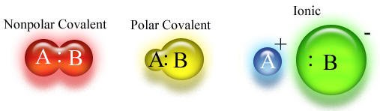
Spectrum of Sharing
Covalent ←→ Polar Covalent ←→ Ionic bonding is a spectrum of atomic affinity for electrons
The spectrum is evidenced by the differences of the electronegativity of atoms
(Nonpolar) Covalent
N—O, diatomic forms (H₂, O₂, N₂), C—H, C—S
Polar Covalent
O—H, N—H, O—C, N—C, O—P
Ionic
Metal + nonmetal: Na+ –Cl, K+ –Cl, Na+ –OH,

Slide 90
Electronegativity Values
H: 2.20 , C: 2.55 , O: 3.44, N: 3.04, P: 2.19 S:2.58
Criteria: Electronegativity Difference (Δ)
Δ < 0.4: covalent
0.4 < Δ < 2: polar covalent
Δ > 2: ionic
Common Bonded Atoms in Biology
O—H 3.44 – 2.20 = 1.24 polar covalent
C—H 2.55 – 2.20 = 0.35 covalent
C—O 3.44 – 2.55 = 0.99 polar covalent
C—N 3.04 – 2.55 = 0.49 polar covalent
N—H 3.04 – 2.20 = 0.84 polar covalent
P—O 3.44 – 2.19 = 1.25 polar covalent
C—S 2.58 – 2.55 = 0.03 covalent
S—O 3.44 – 2.58 = 0.86 polar covalent

Slide 91
Ions
electrically charged atoms and molecules
ionized atoms: Na⁺, Cl–, K⁺, Ca²⁺, Mg²⁺
ionized molecules
H₃O⁺, HPO₄^{2–}, NH₄⁺ C₄H₄O₄^{2–} (succinate: molecular formula) –OOC-CH₂-CH₂-COO– (succinate: structural formula)
cations: positively charged ions
move toward cathode (– pole)
anions: negatively charged ions
move toward anode (+ pole)

Slide 92
The Molecule
Atoms that are covalently bonded to each other
Ionic compounds (and their solid forms crystals) (e.g. NaCl, table salt) are not molecules because the bonding is not covalent
A group of bonded atoms that are all non-metal atoms is a molecule

Slide 93
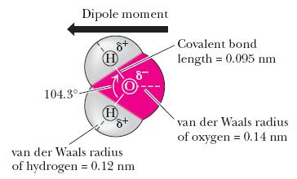
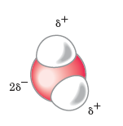
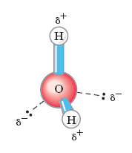
H₂O – Structure
O atom more electronegative
greater affinity for electrons
both bonding and nonbonding electrons (electron pairs)
O-H bond covalent ("shared" bonding electrons) but polar
Garrett & Grisham, Biochemistry (5ed, 2013)
Lehniinger, Biochemistry (4ed, 2005)

Slide 94
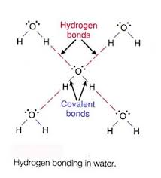
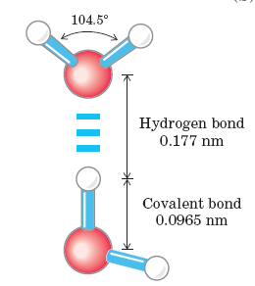
Water – Hydrogen Bonding
H-bonding: the H atom covalently bonded to an O atom in one H₂O molecule forms a weak bond with one of the two unbonded pairs in the valence shell of the O atom of another H₂O molecule
A "weak" bond is a relatively lower energy bond than the covalent bond, but still significant
Water (liq H₂O) forms at temperatures < 100°C with H bonds
These are broken when water boils

Slide 95
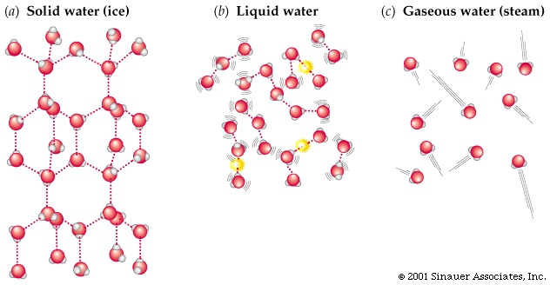
H₂O Phases
ice: H-bonded in a less dense space
water: H-bonds formed & unformed rapidly in more dense space
vapor: no H-bonding as they gallivant through space
animation shows H₂O as water solvating a chloride ion. Note yellow flashes are H-bonds forming & unforming

Slide 96
Water – Properties
High specific heat 1 cal/g/°C
This enables water to resist changes in temperature when heat energy enters or exits
Polar
A great many organic and inorganic solutes dissolve in it, providing the environment for biochemical reactions
Cohesive because of the H-bond
Water's surface tension resists loss of solvent as well as accounts for capillary flow exploited by organisms
Organisms composed of 70-90% water

